Slide 1
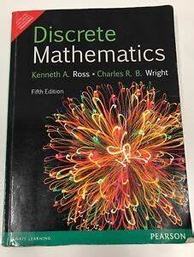

Logical Operator – Bioconditional Operator
By Mohammed Ahsan Meah

Slide 2


Slide 3
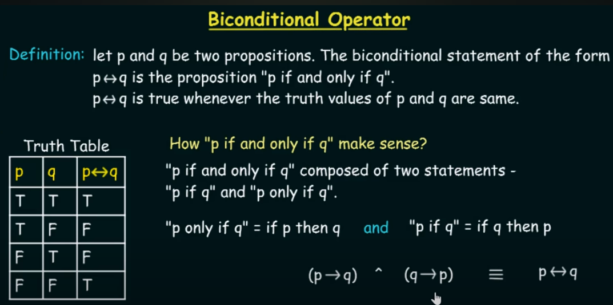

Slide 4
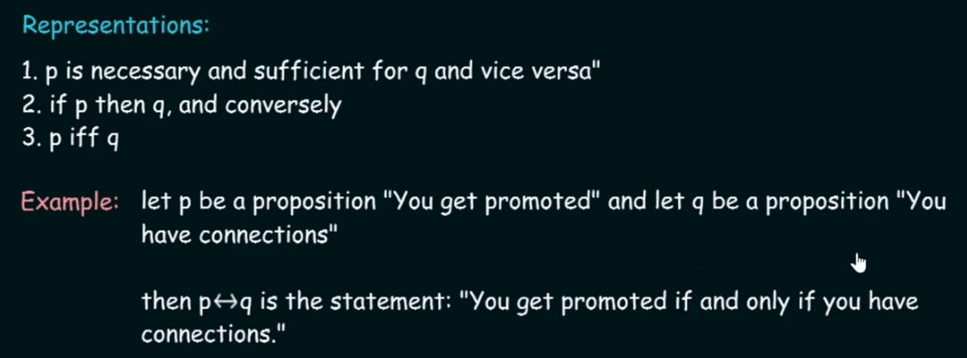

Slide 5


Slide 6


